Slide 1

Database for Counterfeit Product Management
ISYS 864 - Data Management for Analytics
Presented By:
Padmasree Sappa

Slide 2



PROJECT OVERVIEW
​
Purpose: Counterfeit product management in
e-commerce​
Focus: Brand registrations, product authenticity,
customer complaints, investigations,
and enforcement actions​
Relevance: Career aspirations in e-commerce
and team member’s prior experience with Amazon

Slide 3
Brand: Details such as the brand name, the date it was registered, the contact
person's name, email, etc.
Product: Information such as the product name, the product category
with Electronics, Clothing, and Furniture as its subtypes, etc.
Key Entities & Attributes
Customer: Records the customer's name, email, phone number, address,
purchase history, and the date of their registration.
Complaint: Tracks the date the complaint was lodged, a description,
the current status, and the date the complaint was resolved.
Investigation: Records the start date , the person assigned to it, the status,
the findings during the investigation, and its conclusion.
Enforcement action: Captures the type of action taken with subtypes, the
date, the status of the action, and the outcome of the enforcement.
Transaction: Records the date of the transaction, the quantity purchased,
the price per unit, and the total amount of the transaction.

Slide 4
BUSINESS RULES
Each product must be registered by only one brand.
Each brand can register many products
Each customer can file many complaints
Each complaint must be filed by one customer.
Each product may receive many complaints
Each complaint must link to one product.
Each complaint can lead to one investigation.
Each investigation must be tied to precisely one complaint.
Each investigation can result in many enforcement actions
Each enforcement action must be related to exactly one investigation.
Each customer can engage in many transactions
Each transaction must involve exactly one customer.
Each transaction must involve at least one product
Each product can be involved in many transactions.

Slide 5
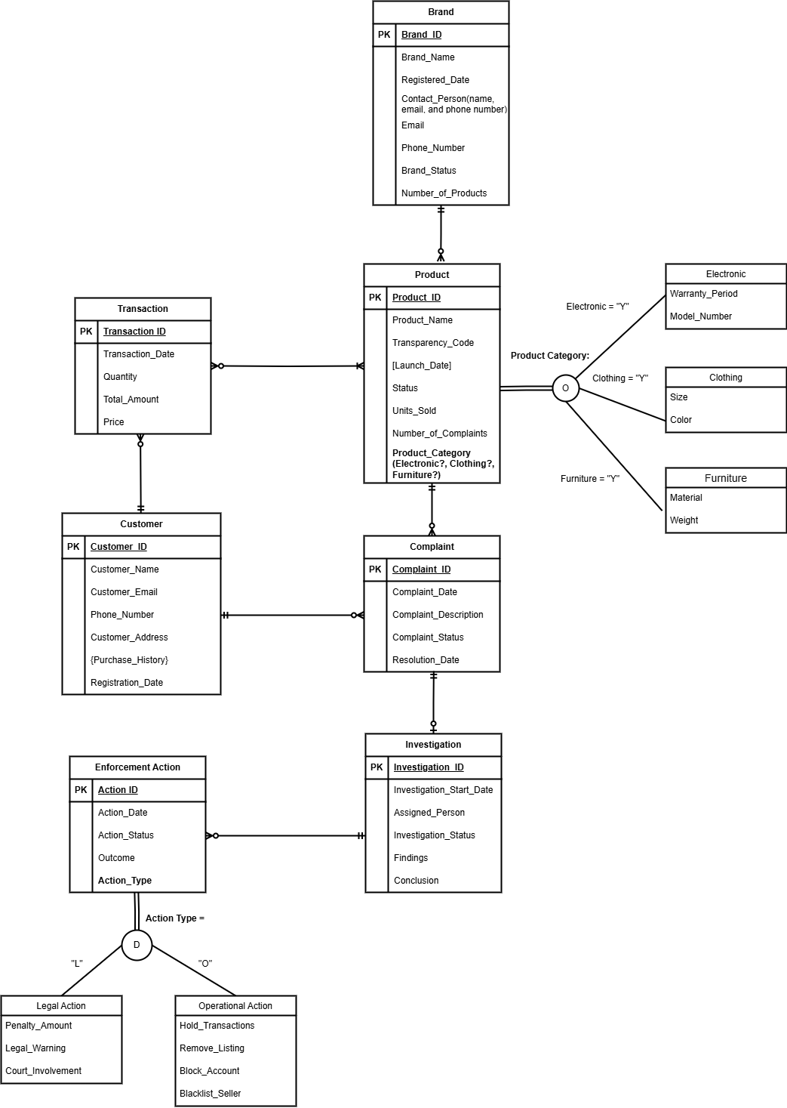
Enhanced Entity-Relationship Diagram

Slide 6
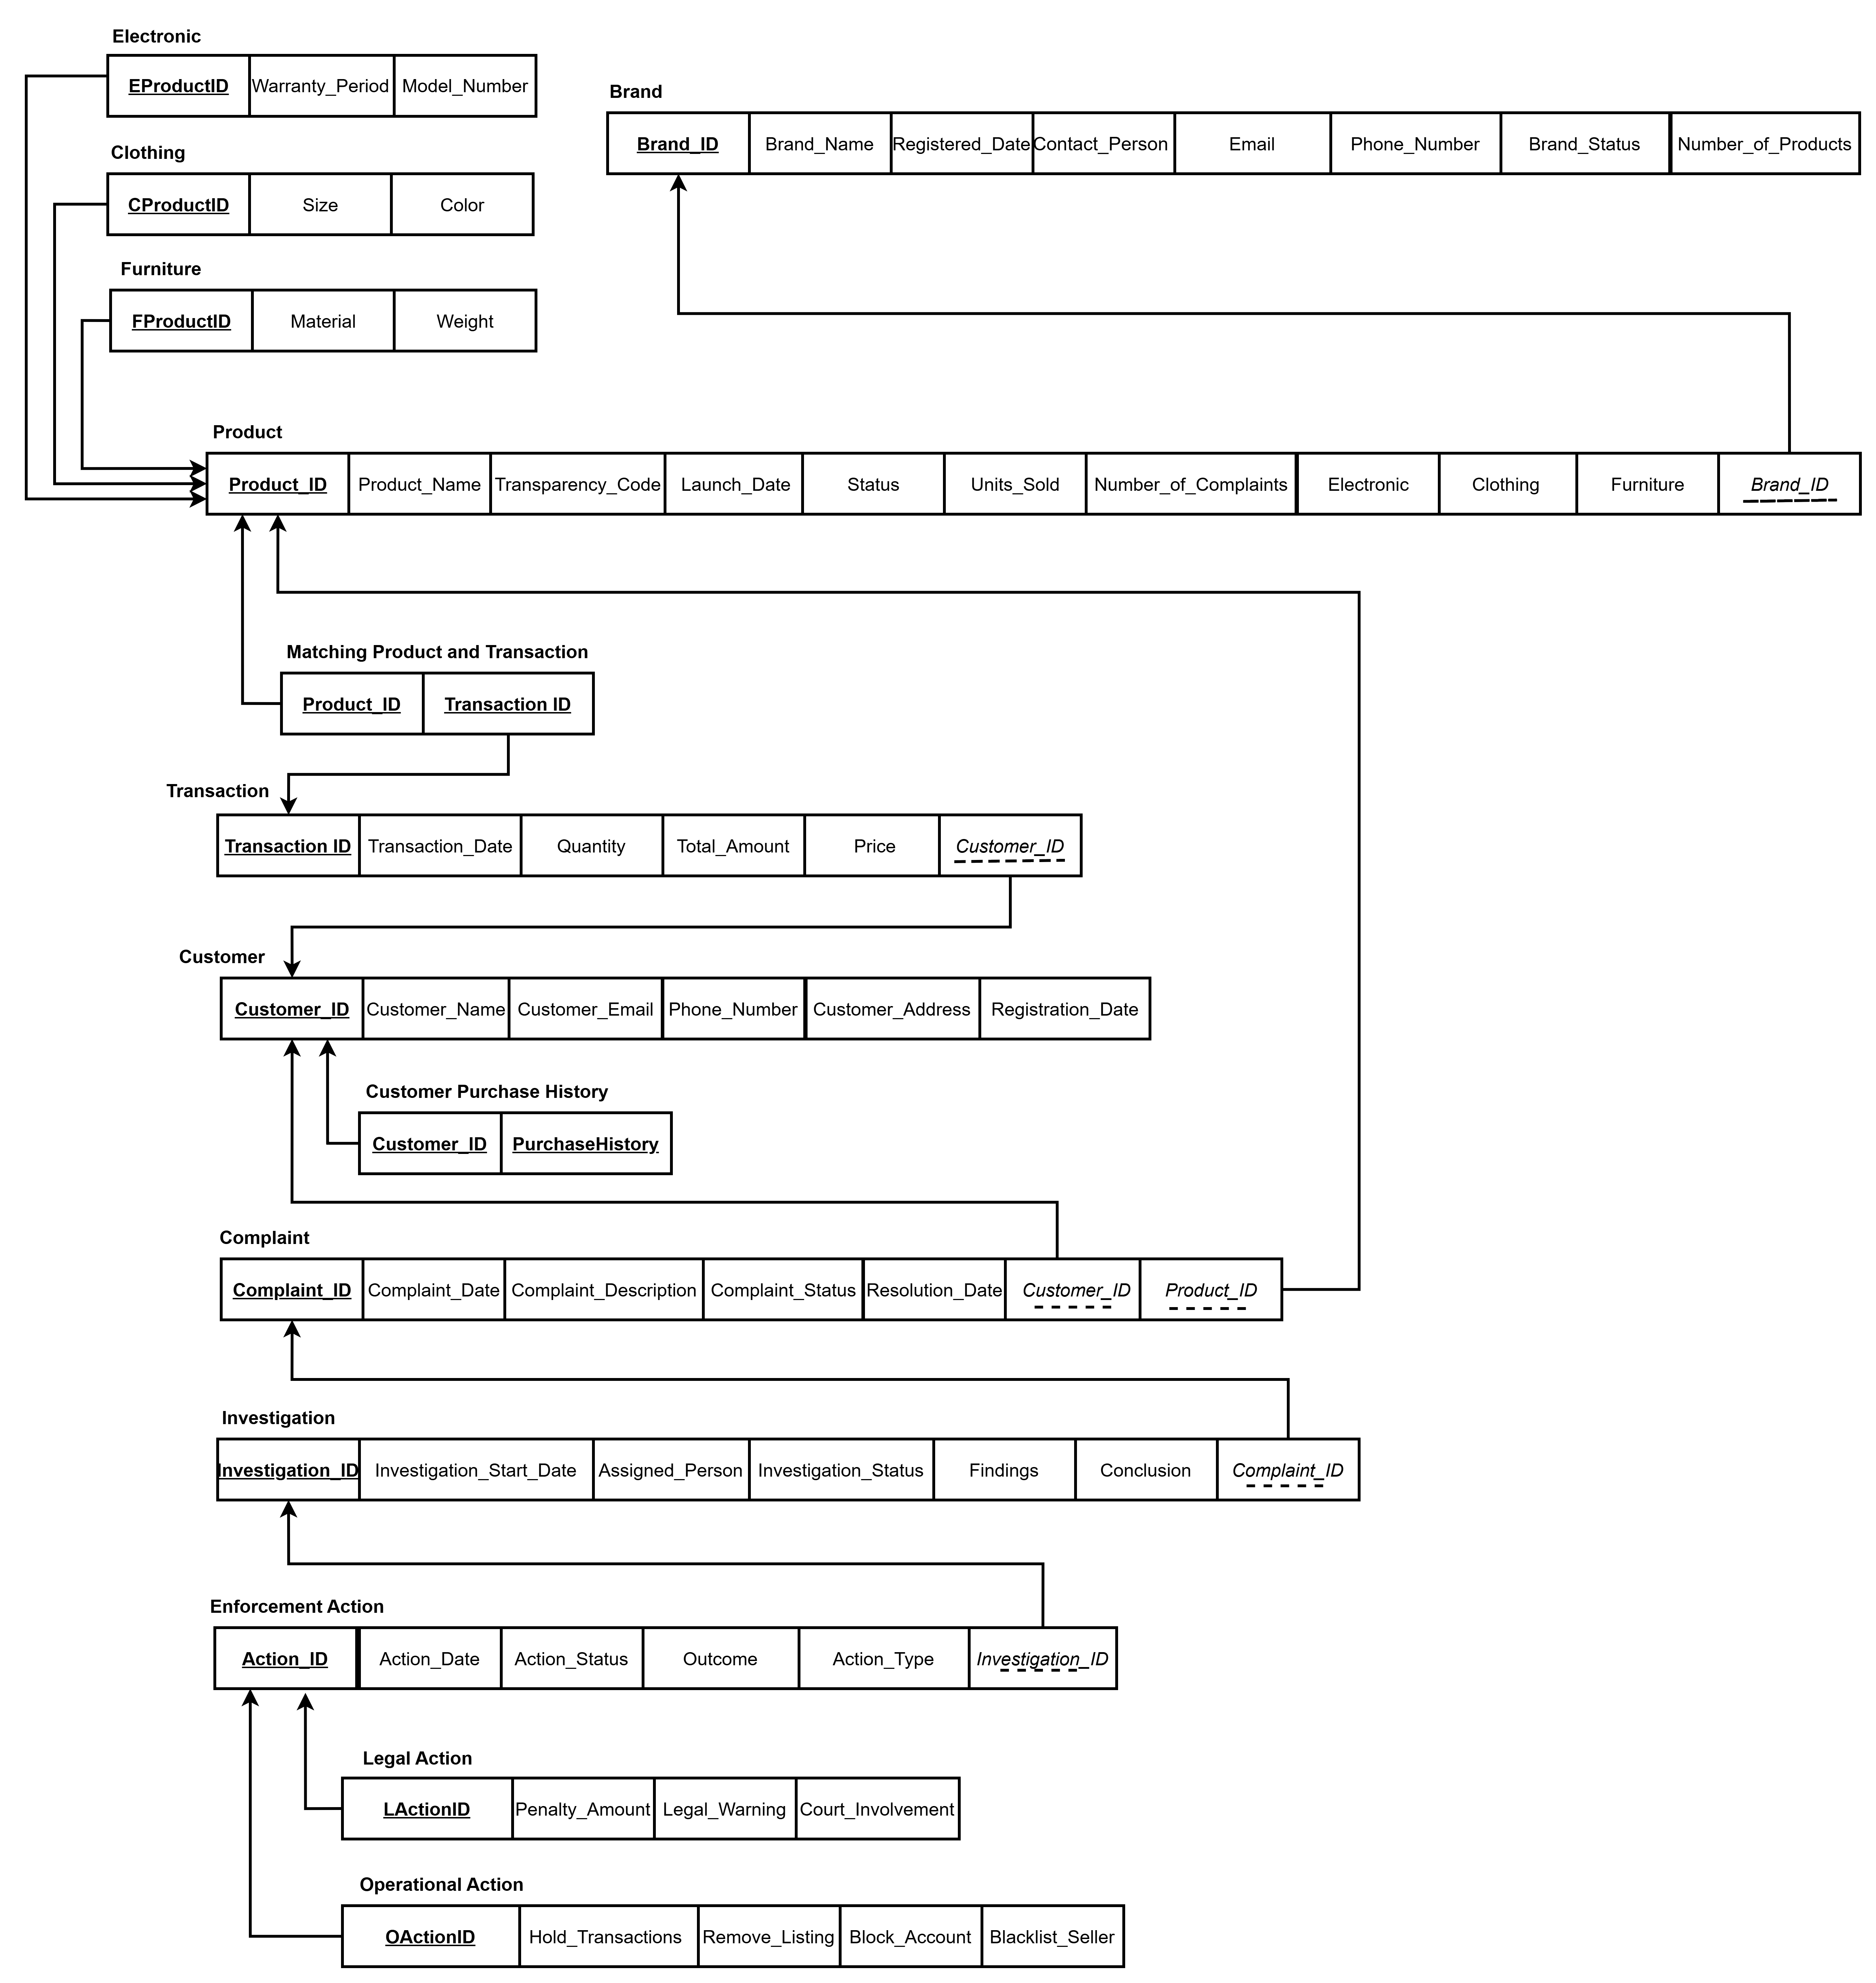
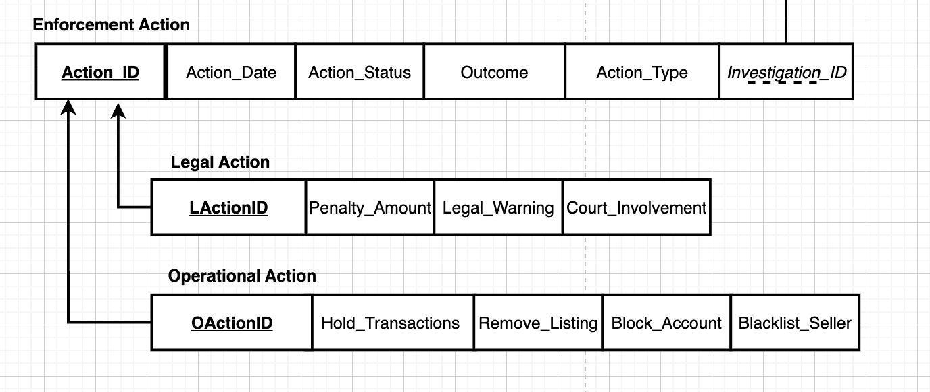
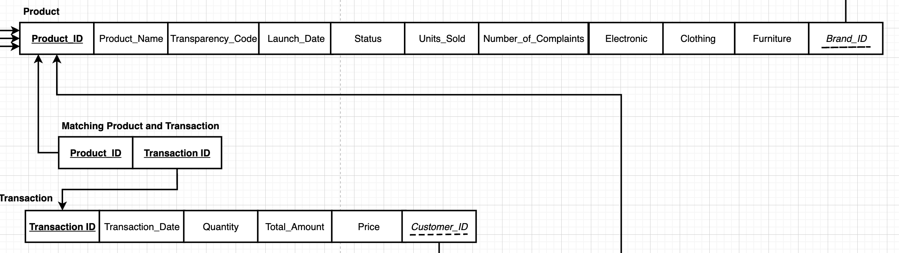
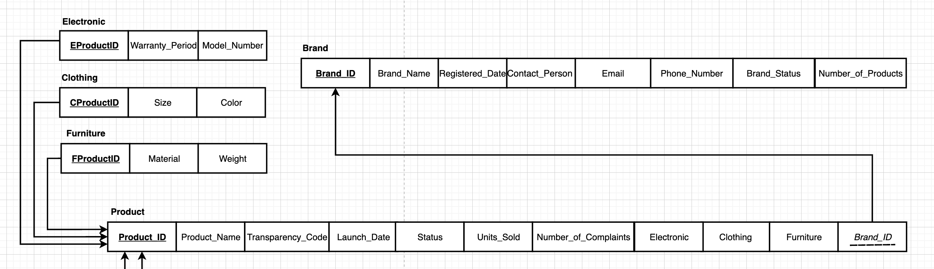
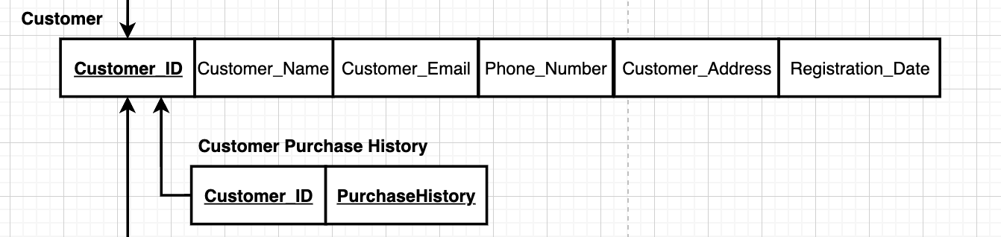
Enhanced Entity-Relation Diagram (3NF)

Slide 7
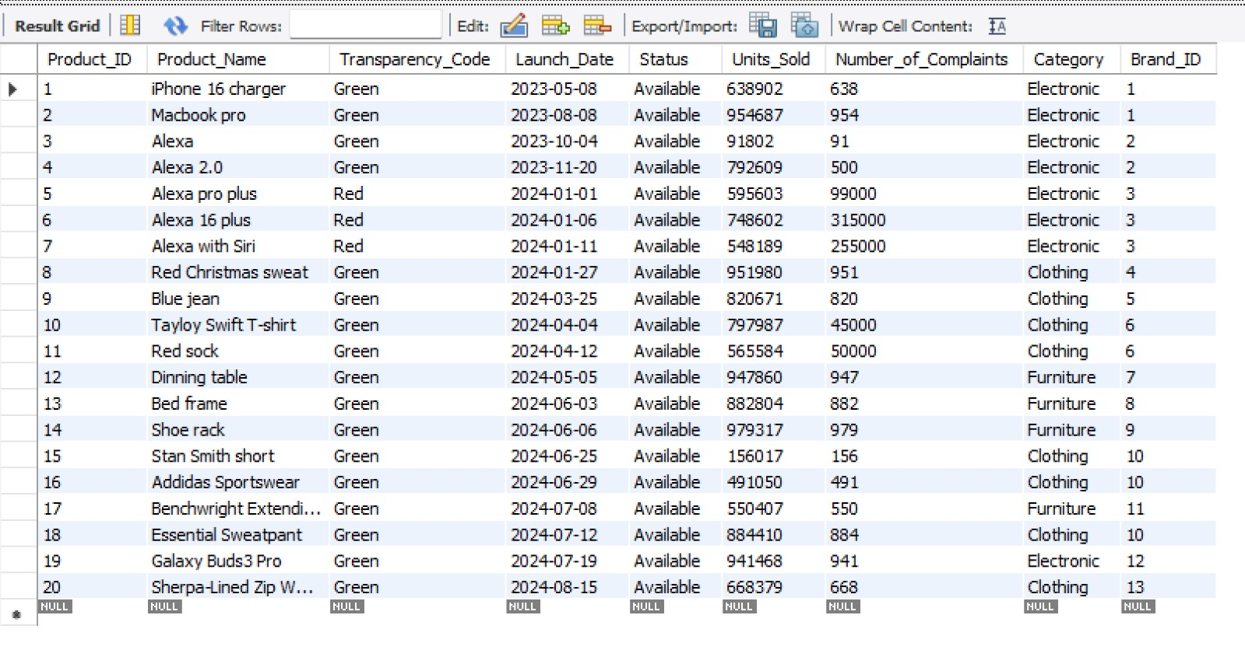
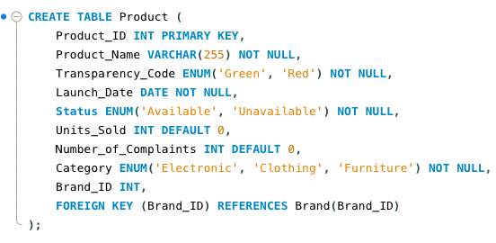
Inserting Data into database
Result
Code

Slide 8
Insights Deep-Dive

Slide 9
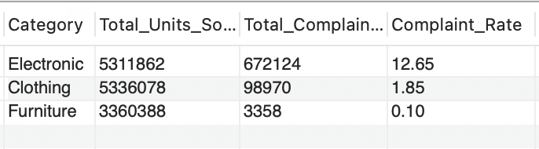
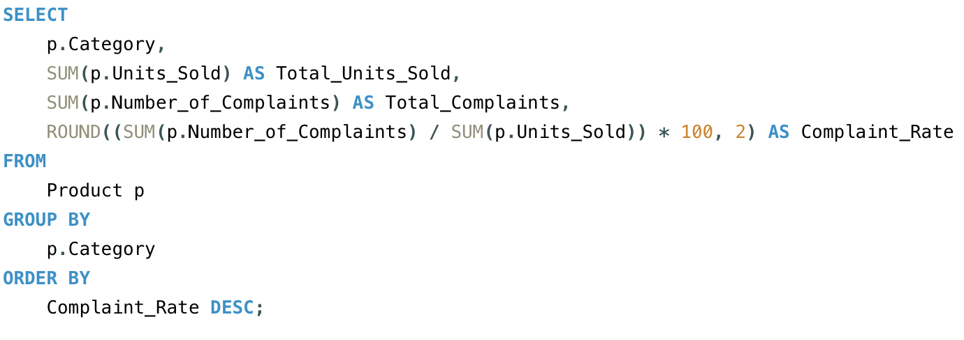
Are there specific product categories more prone to fraud?
Result
Logic
Group + Aggregation Function
Code
12% Complaint Rate in Electronic
Electronics and clothing categories may have quality issues or fraudulent
13%
Make a big impact with professional slides, charts, infographics and more.

Slide 10
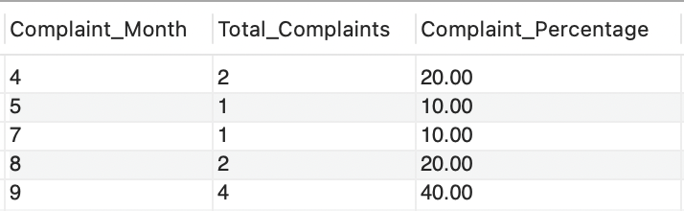
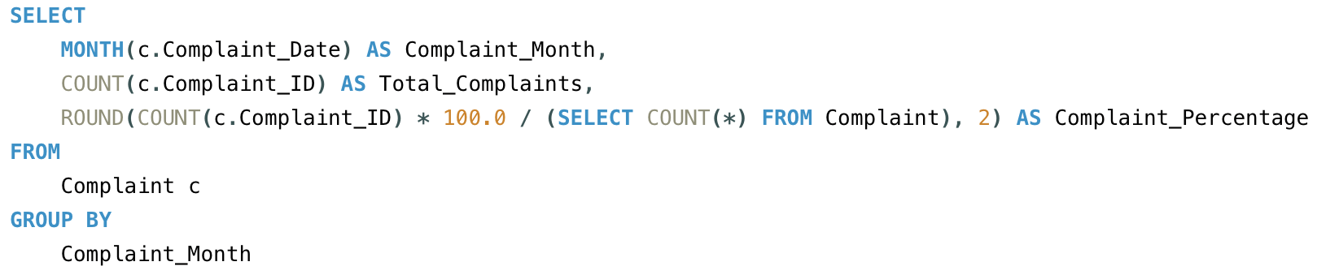
Are there any seasonal trends in complaint rates?
Result
Logic
Group + Aggregation Function
Code
Q3 contributes more than 2/3 of complaints
Q3 spikes may indicate fraudulent activity during high-demand periods (e.g., holidays)

Slide 11
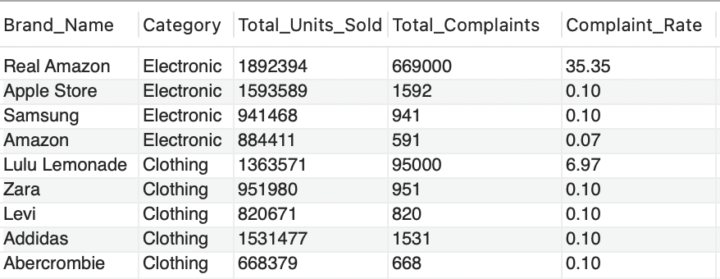
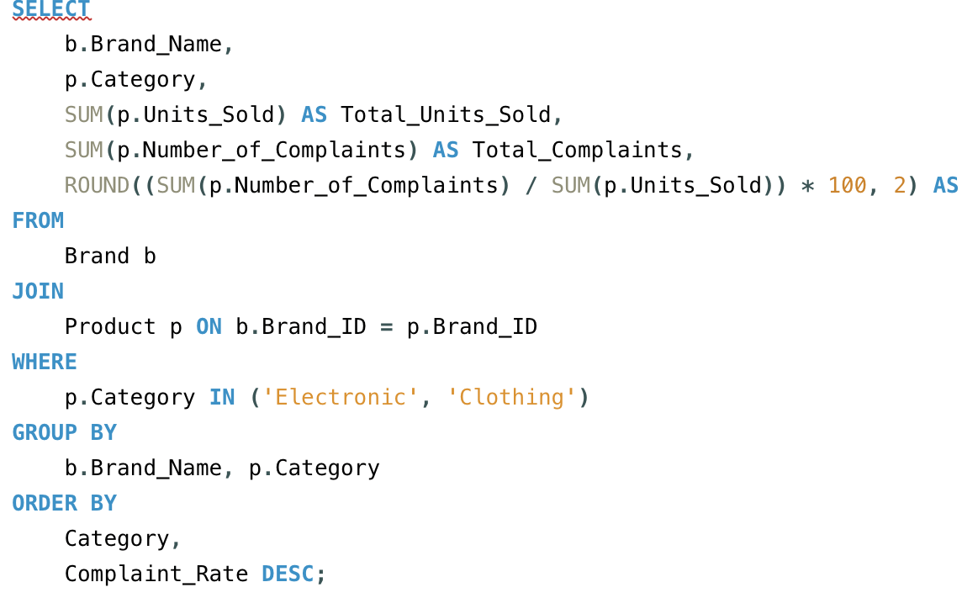
Which brands in these categories contribute to the high number of complaints?
Result
Logic
Join Table
Group + Aggregation Function
Code
Real Amazon has a complaint rate of 35%
Real Amazon and Lulu Lemonade are likely selling fraudulent products or have quality issues.
13%
Make a big impact with professional slides, charts, infographics and more.

Slide 12
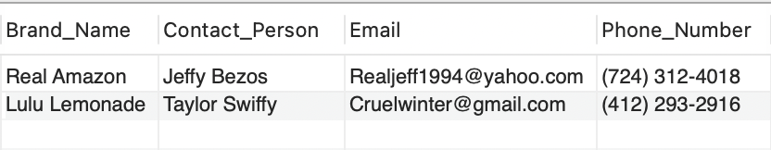
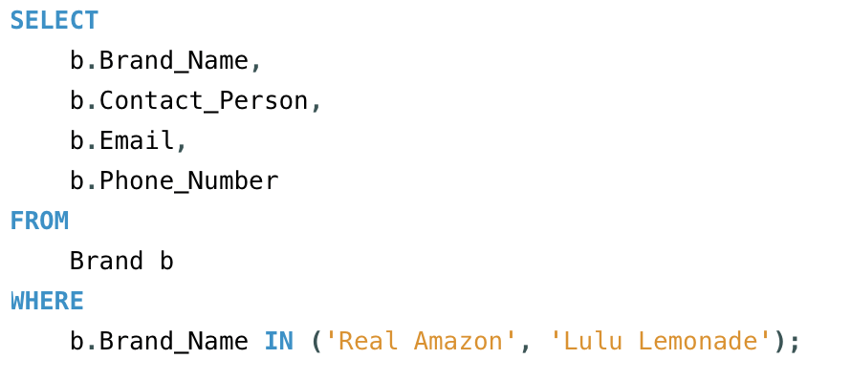
Who is the contact person for these problematic brands?
Result
Logic
Indicate the condition
Code
Suspicious seller profile
False identities are likely to sell fake products. Contact information will help follow up investigations and enforcement.
Make a big impact with professional slides, charts, infographics and more.

Slide 13
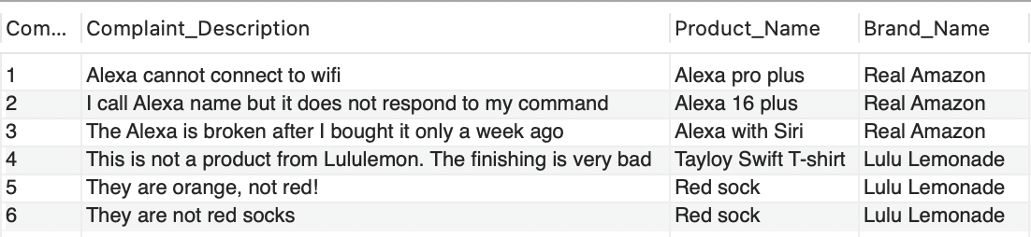
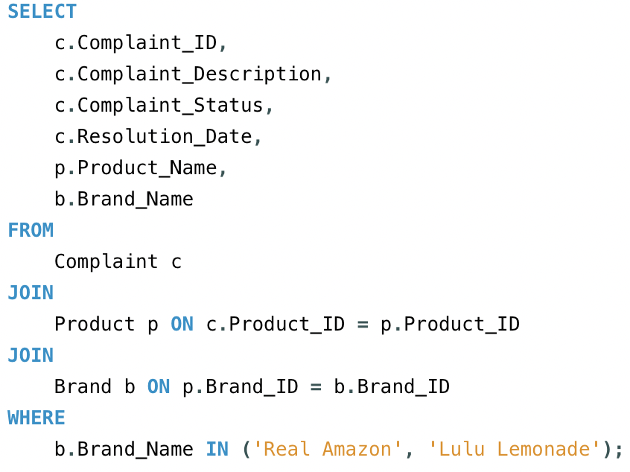
What are the specific customer complaints about these brands?
Result
Logic
Join tables
Indicate condition
Code
Products are malfunctioning and do not match their marketing
Complaint details provide insights into how products may be defective or fake
Make a big impact with professional slides, charts, infographics and more.

Slide 14
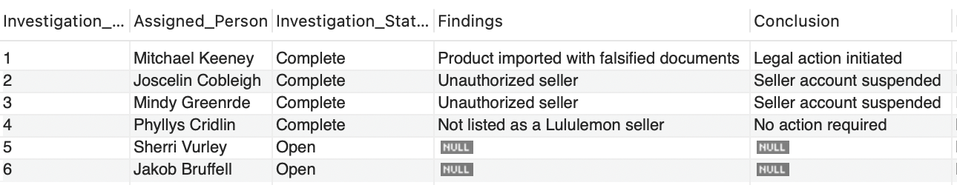
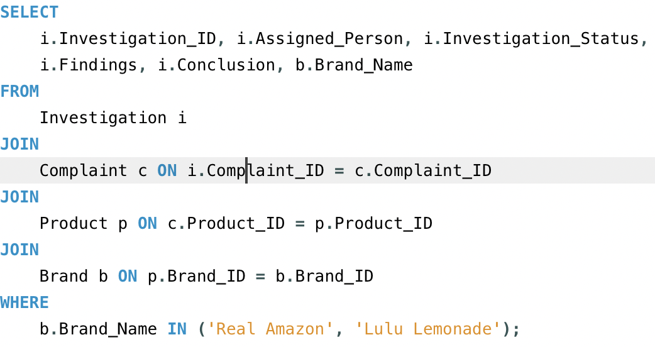
Have we taken any action to investigate these brands?
Result
Logic
Join tables
Indicate condition
Code
All investigations into Real Amazon brand are complete
Suspicious seller profile
Amazon actively investigates and addresses issues to combat counterfeit products and removes problematic brands
Make a big impact with professional slides, charts, infographics and more.

Slide 15
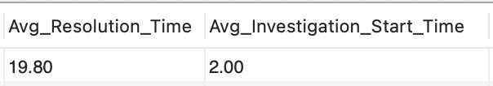
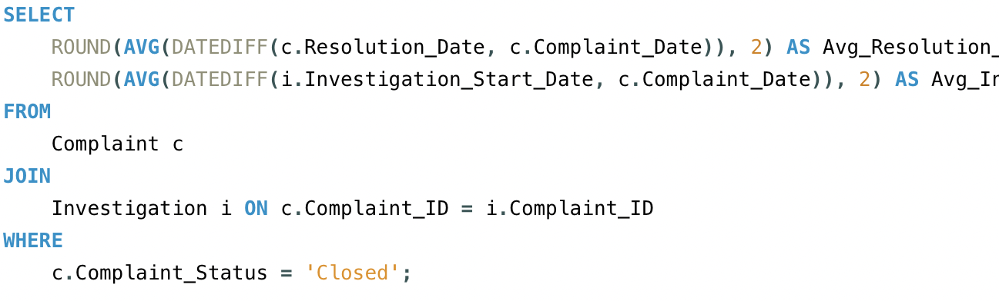
What is the average time taken to resolve complaints?
Result
Logic
Find average date difference
Indicate condition
Code
Cases take roughly 3 weeks to get resolved
Suspicious seller profile
Helps track and improve the complaint-handling timeline, ensuring better customer satisfaction
Make a big impact with professional slides, charts, infographics and more.

Slide 16
Counterfeit Assessment

Slide 17
Products with a complaint rate > 5% and the number of complaints > 50
High-Risk Product Percentage
Assess the proportion of complaints that were successfully resolved (Complaint_Status = 'Closed')
Resolution Efficiency Percentage
Assessment Matrix
Assess the average time (in days) taken to close complaints
Average Resolution Time
Assess the percentage of all investigations that have successfully closed (Investigation_Status = 'Complete') ?
Investigation Efficiency Percentage
Top Complaint Brand
Highlight the active brands needing immediate focus

Slide 18
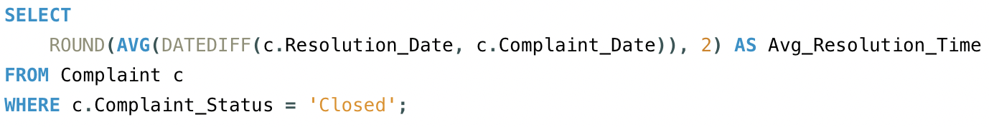
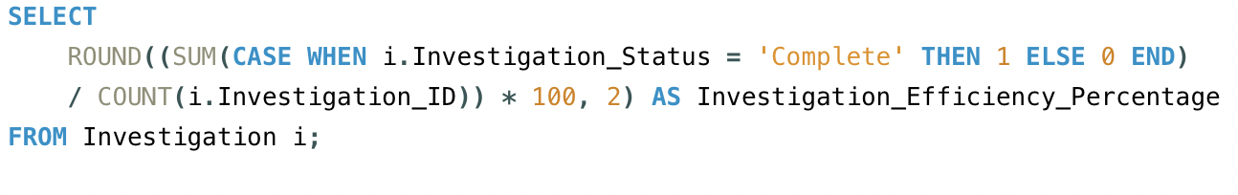
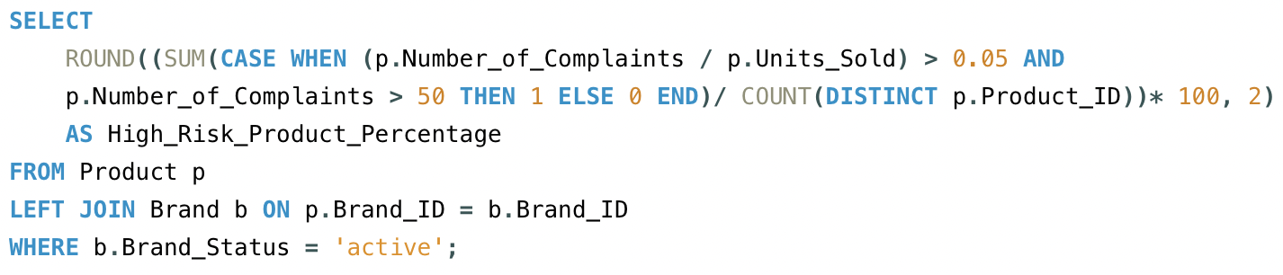
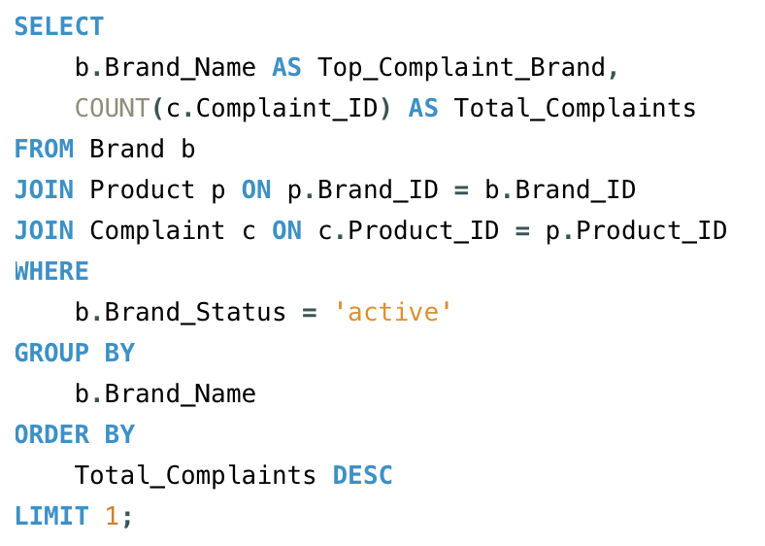
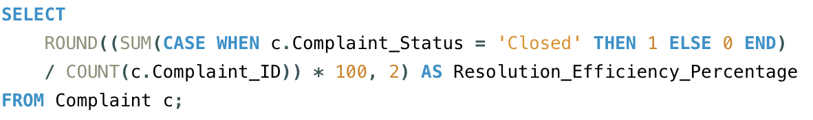
Join tables
Aggregation function and group
Control statement
Indicate condition
Logic
Average Resolution Time
Code
Investigation Efficiency Percentage
High-Risk Product Percentage
Top Complaint Active Brand
Resolution Efficiency Percentage
Make a big impact with professional slides, charts, infographics and more.

Slide 19
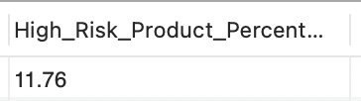
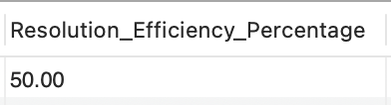
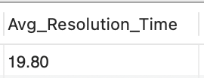
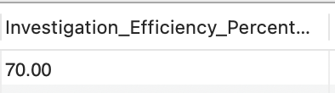
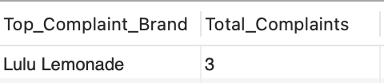
Counterfeit Assessment Results
High-Risk Product Percentage
Resolution Efficiency Percentage
Average Resolution Time
Investigation Efficiency Percentage
Top Complaint Active Brand

Slide 20
Conclusion
Successful Implementation
The database enables Amazon to track brands and products, facilitating efficient identification and removal of counterfeit goods.
Improved Monitoring and Action
By centralizing information, the system empowers Amazon to take timely action against problematic brands and sellers.
Need for Increased Efficiency
Approximately 50% of cases remain unresolved after three weeks, highlighting the need for further optimization of internal processes and resource allocation.
Notes:
1.The project successfully delivered a comprehensive database system for managing counterfeit product. This database enables Amazon to effectively track brands, products, customer complaints, and investigation details, facilitating more efficient identification and removal of counterfeit goods.
2. The database provides Amazon with valuable tools to monitor and address counterfeit product issues. By centralizing information, the system empowers Amazon to take timely action against problematic brands and sellers.
3. Despite the successful implementation of the database, analysis reveals that Amazon's efficiency in resolving counterfeit cases needs improvement. Approximately 50% of cases remain unresolved after three weeks, highlighting the need for further optimization of internal processes and resource allocation.

Slide 21

THANK YOU
Q&A

